Slide 1
Detoxification
Semester 2

Slide 2
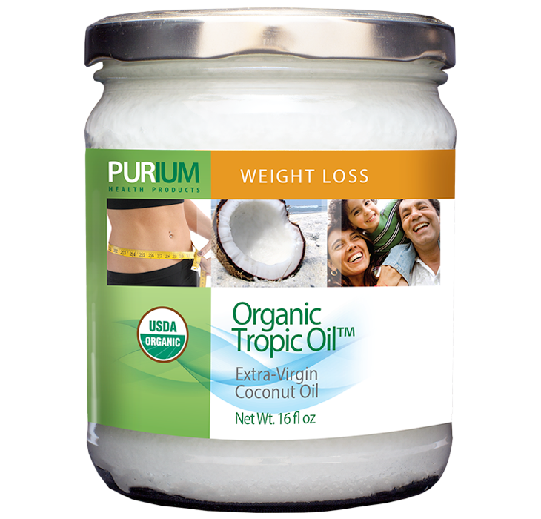
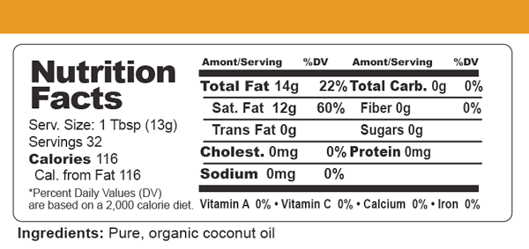
Tropic Oil

Slide 3
Tropic Oil
What it is: Purium`s Organic Tropic Oil is 100% pure, fairly traded coconut oil from the Philippines
Benefits:
1 May help improve nutrient absorption
2 Does not contain any cholesterol nor promote platelet stickiness in the blood
3 Stable under high heat, which means it is an ideal oil for cooking
4 Healthy alternative to butter or margarine

Slide 4
Tropic Oil
Interesting Facts:
Pure white, fresh and creamy, Tropic Oil naturally remains stable even in tropical heat, so its freshness lasts.
Coconut oil is one of the only natural food sources of monolaurin, which is the nutrient in mother’s breast milk that helps build up a breastfeeding baby’s immune system – best when taken raw to enjoy the immune supporting capabilities.
Coconut oil contains zero cholesterol and zero dangerous trans-fats (which are found in hydrogenated oils)
Contains medium chain triglycerides (MCTs), which are healthy fats that burn easily without stimulating weight gain or fat storage

Slide 5
Tropic Oil
Interesting Facts:
Pure, organic coconut oil is the safest, healthiest and best tasting oil to fry foods over medium heat. You can fry eggs, chicken, and even use it in stir-frying. You can also substitute coconut oil for vegetable oil in baked goods to make them healthier.
An amazing moisturizer, coconut oil helps relieve skin dryness from eczema, sunburn, or low humidity
The best massage oil as it melts at 76° F or above, it creates a sensual experience when it touches your skin
Great for shaving, it helps reduce ingrown hairs, cuts, and abrasions while leaving your skin baby soft
May help prevent stretch marks when used liberally on belly and breasts during pregnancy. Can also be used on tender breasts when nursing to help relieve discomfort

Slide 6
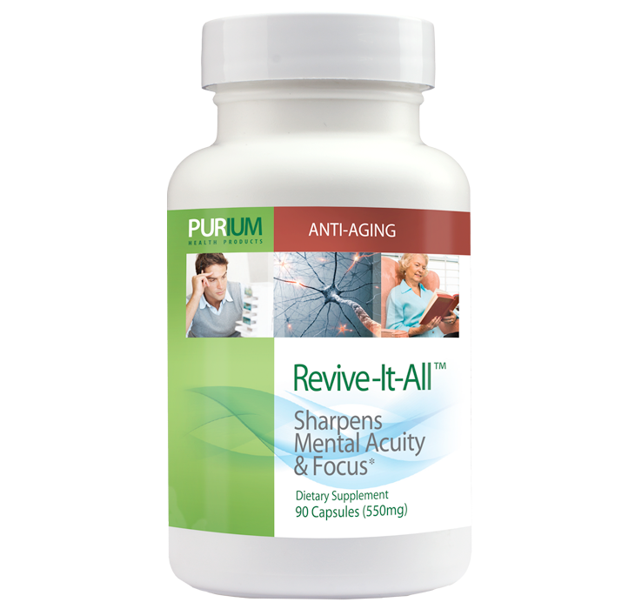
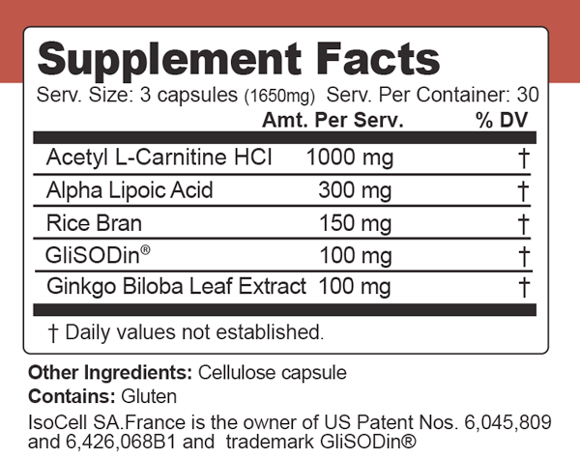
Revive-It-All

Slide 7
Revive-It-All
What it is: A scientifically combined proprietary blend of herbs and whole foods designed to help improve circulation, cognition, memory, and other age-related degeneration.
Benefits:
Can help improve mood, memory, and cognition
May help increase energy and vigor
Can enhance circulation
May support lower blood pressure

Slide 8
Revive-It-All
Interesting Facts:
According to a study at the University of California, Berkeley, dated February 19, 2002, two dietary supplements put the spark into aging rats and might do the same for people. Doctor and Researcher Bruce Ames, and others observed reversal in memory loss, increased vigor, and increased energy in the animals that were taking Acetyl L-carnitine with Alpha Lipoic Acid. Their conclusion, if you tune up the mitochondria you may have a means of delaying at least the onset of a number of age-related problems that we encounter, and we can in some ways, hopefully, reverse what has already taken place. People use acetyl-L-carnitine to maintain their immune competence and reduce the formation of the aging pigment lipofuscin. The most important effect of acetyl L-carnitine, however, is to maintain the function of the cell`s energy powerhouse, the mitochondria. Published research continues to substantiate the multi-faceted benefits of this critical amino acid supplement. It has the ability to squeeze through even the narrowest of blood vessels to increase the supply of oxygen to the heart, brain, and all other body parts. This aids in mental functioning and helps to relieve muscle pain.

Slide 9
Revive-It-All
Interesting Facts:
Alpha Lipoic Acid is a powerful antioxidant that studies show may help reduce pain, burning, itching and numbness associated with nerve damage caused by diabetes. Studies also indicate that Alpha Lipoic Acid may speed the removal of glucose from the blood in people with Diabetes.
Alpha Lipoic Acid also ensures the proper functioning of two key enzymes that convert food into energy.
Superoxide dismutase (SOD) is a vital endogenous antioxidant enzyme known to produce a wide range of health benefits. SOD`s actions against free radicals are paramount in prevention and treatment of disease and maintenance of cellular health.
Decreased production of SOD contributes to aging and possible development of degenerative concerns.

Slide 10
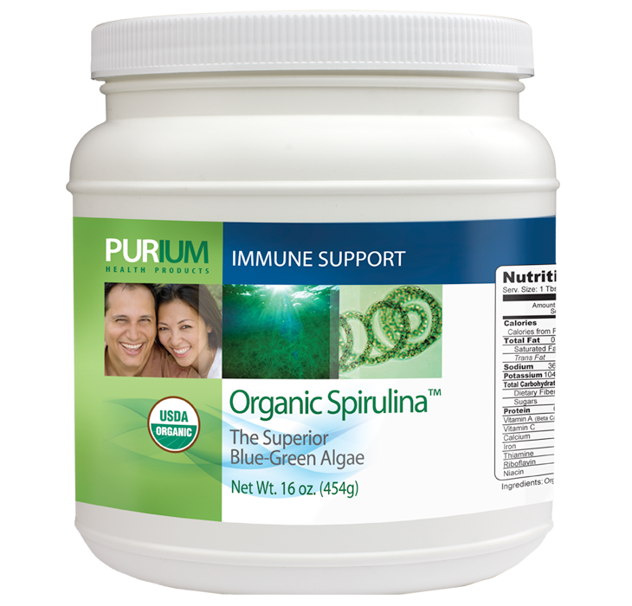
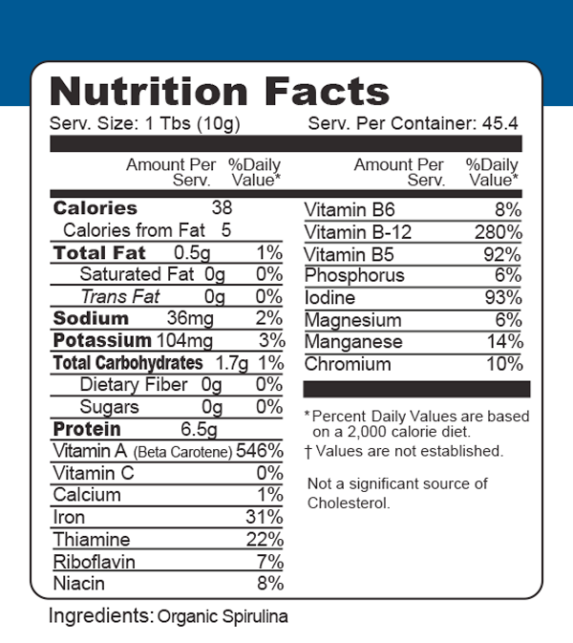
Spirulina

Slide 11
Spirulina
What it is: A cyanobacterium of the genus Spirulina, it is a unique alga with abundant nutrients and pigments that grows in semi-brackish water.
Benefits:
Can help increase endurance and stamina
Is a rich source of carotenoids
May reduce cravings and appetite
May support healthy immune function
Can help promote healthy cholesterol levels and cardiovascular function

Slide 12
Spirulina
Interesting Facts:
Believed to have been a staple in the ancient Aztec diet, today Organic Spirulina is considered one of the most nutrient-dense foods on the planet. The highest quality blue-green algae available, PHP`s Organic Spirulina is grown in a scientifically controlled environment, which allows us to guarantee there is no superior spirulina on the planet! Well known as an excellent source of easily digestible protein, our Organic Spirulina contains 100-plus health-promoting nutrients, including vitamin E, vegetarian B12, iron, calcium, protein, vitamins, minerals, all 9 essential amino acids, and chlorophyll. An excellent source of the rare but important fatty acid GLA, Organic Spirulina is also superabundant in antioxidants. No wonder it`s a favorite food of athletes, who use it for bodybuilding, energy and endurance. It is available in powder and tablets. Scientific studies at UC Davis show that Organic Spirulina may be the most potent immune boosting food ever studied. After only 2 weeks, gamma interferon and interleukin levels increased by up to 10 times. These are essential for the body to battle a wide variety of cellular imbalances. Our organic Spirulina is grown in closely monitored conditions in China in salt water.

Slide 13
Spirulina
Interesting Facts:
Various types of kelp and other sea plants have been used traditionally by coastal societies for centuries, the use of Spirulina as a food is a rather different story. Although its scientific documentation as a "superfood" did not occur until the 20th century, its first use was actually 200 years prior to that when a severe drought hit the South American continent. Facing starvation the indigenous people gathered green algae from tidal pools that were rapidly reproducing in the mid summer`s heat. It was not until World War II, however, when facing an embargo that the Japanese government created the Society for the Study of Algae. After intensive research two strains were found to have the perfect complement of protein, carbohydrates, minerals and essential fatty acids necessary to support human life. These were called Chlorella (grown in fresh water) and Spirulina (grown in salt water). A brilliant scientist named Dr. Hiroshi Nakamura then created unique aqua (water) culture models capable of producing many tons of this life giving superfood. After the war the project continued and Dr. Nakamura traveled to the United States to share his discovery with another brilliant phyco-biologist (sea plant biologist) named Dr. Christopher Hills. Together they planted the seeds of research over 30 years ago that have resulted in spirulina taking its place among the most powerful health promoting foods on earth.

Slide 14
Spirulina
Interesting Facts:
Spirulina is Nature`s Richest Food Source of:
Vitamin B-12. It`s two to six times richer than the nearest rival, raw beef liver. B-12 is practically a synonym for high energy.
Bio-chelated Organic Iron, which is completely nontoxic. It`s 58 times richer than raw spinach and 28 times richer than raw beef liver!
Vitamin E. It`s 3 times richer than raw wheat germ and its biological activity is 49% greater than synthetic vitamin E.
Beta-Carotene (Pro Vitamin A). It`s 25 times richer than raw carrots. Unlike the preformed vitamin A of synthetics and fish liver oils, beta-carotene is completely nontoxic even in mega doses.

Slide 15
Spirulina
Interesting Facts:
Spirulina is Nature`s Richest Food Source of:
Antioxidants. It contains a spectrum of every natural antioxidant known, including: the antioxidant vitamins B-1 and B-6; the minerals zinc, manganese and copper; the amino acid methionine; and the super antioxidants beta-carotene, vitamin E and trace element selenium.
Gamma Linolenic Acid (GLA). Its oils are 3 times richer in GLA than evening primrose oil. Studies have indicated that GLA helps lower blood cholesterol and high blood pressure and eases such conditions as arthritis, premenstrual pain, eczema and other skin conditions.
Chlorophyll - many times richer than alfalfa or wheat grass!
Complete High-Biological Value Protein: Spirulina - 60-70%, Soybeans - 30-35%, Beef - 18-22%, Eggs - 12-16%, Tofu - 8%, Milk - 3%

Slide 16
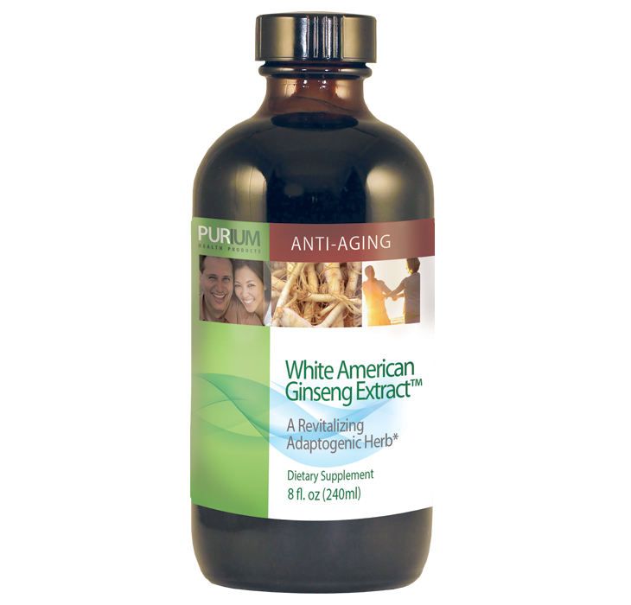
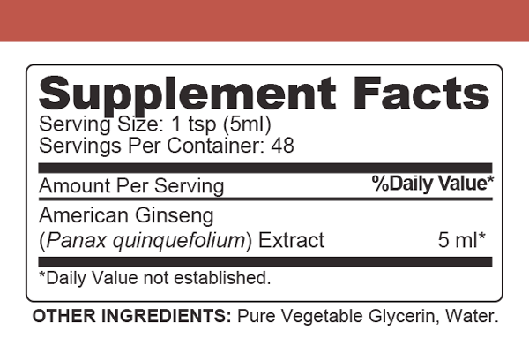
White American Ginseng

Slide 17
White American Ginseng
What it is: The master herb of Chinese medicine and used widely in Native American medicine, this herb has been used for centuries for its impressive ability to revitalize and restore balance in the body, as well as for its potential life extending properties.
Benefits:
Can support healthy responses to physical and psychological stress
May support healthy blood glucose levels
Can support healthy cholesterol levels and cardiovascular function
May help improve memory
Is considered better for women`s health issues than Chinese or red ginseng

Slide 18
White American Ginseng
Interesting Facts:
White American Ginseng is recognized internationally as the ginseng of choice. Our White American Ginseng contains at least 28 active gensenosides, all pure, including calming and stimulating elements that promote energy without jitters. When taken, the body knows where its healing properties are most needed to maximize its calming, energizing balance.
Throughout history ginseng has been used for its powerful abilities to revitalize and restore balance in the body. It is the master herb of Chinese medicine, and Native Americans use it for its curative and life-prolonging properties, as well.

Slide 19
White American Ginseng
Interesting Facts:
Energy, Alertness, Reflexes, and Endurance- In the 1980s, a researcher at the University of California discovered that ginseng promoted more efficient use of the body-energy and provided extra storage of energy-producing compounds in the liver. In this study it was found that when animals were subjected to extensive exercise, their energy levels were less depleted in the presence of ginseng. It has later also been discovered that ginseng can regulate the basal metabolic rate, which in turn can increase the breakdown and metabolism of foods, liberate more energy and remove more waste products. Perhaps it is these unique metabolic effects that have led some researchers to conclude that ginseng can prevent hangovers. Ginseng constituents such as the ginosenosides may affect the nervous system, blood flow to the brain, and certain brain neurotransmitters. American ginseng has been shown to contain 3-4 times as much ginosenosides as Korean or Chinese ginseng.

Slide 20
White American Ginseng
Interesting Facts:
May lower blood pressure- American ginseng contains compounds called saponins that regulate both the strength of the heartbeat and blood pressure; American ginseng also lowers blood pressure by stimulating the conversion of the amino acid arginine to nitric oxide which causes the walls of the blood vessels to relax.
Aids in Stress- Like other forms of ginseng, American ginseng has traditionally been applied to restoring health after periods of illness or prolonged stress. Research has repeatedly shown that ginseng helps the body cope with stress.
Cardiovascular Health- Ginseng has been shown to have a positive effect on the cardiovascular and central nervous systems. There are also several studies suggesting that ginseng reduces cholesterol in the circulation. Though the ginseng itself is not a cholesterol lowering agent, better circulation is a welcome byproduct of cleaner metabolism, which it promotes.

Slide 21
White American Ginseng
Interesting Facts:
Preventing Infections- In Japan, researchers found that ginseng can boost the immune system by fortifying both the white blood cells that stand guard as well as the antibodies that are their weapons. Ginseng furthermore enriches the blood with protective cells and accelerates the proliferation of these cells in the bone marrow.
Aging- Ginseng alleviates some of the most common effects of aging, such as the degeneration of the blood system. Ginseng has been shown to help treat cardiovascular disease as well as help relieve tiredness. It is therefore considered a safe long-term stimulant. In China an ancient and reverent tradition has evolved between elderly Chinese and their ginseng. Many who are "getting on in years" have discovered that American ginseng can substantially alleviate arthritis.

Slide 22
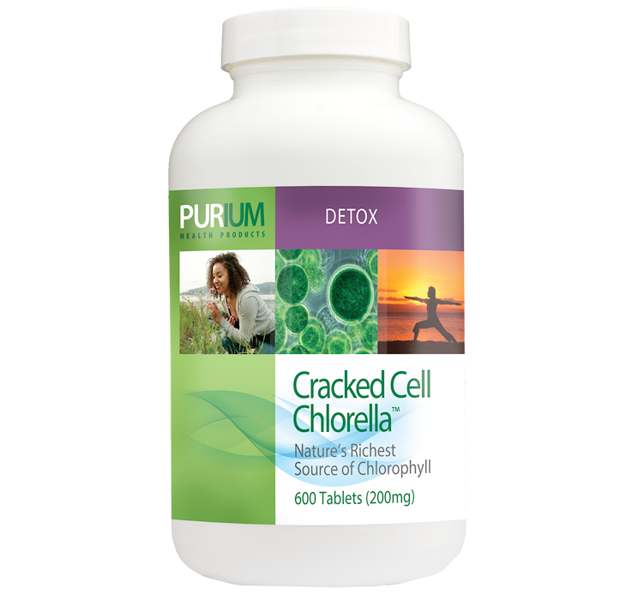
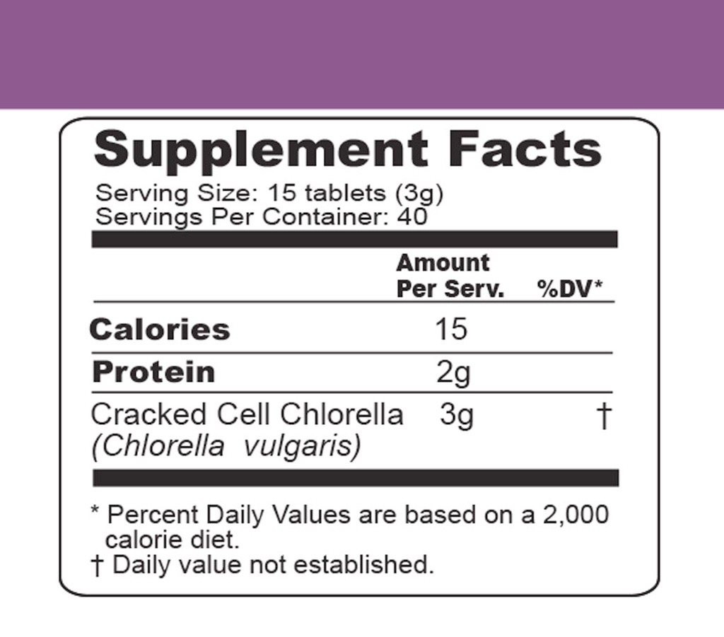
Chlorella

Slide 23
Chlorella
What it is: Chlorella is a single cell blue green alga that is nature`s richest whole food source of chlorophyll. Purium`s Cracked Cell Chlorella has been sonically "cracked."
Benefits:
Can help break down heavy metals
May support natural detoxification
Is nature`s richest whole-food source of chlorophyll
May help decrease plaque buildup in arteries
May support healthy cholesterol levels

Slide 24
Chlorella
Interesting Facts:
The best selling supplement in Japan, Chlorella a single cell algae and is nature`s richest whole food source of chlorophyll, a powerful cleanser and detoxifier for the body and contains abundant RNA, plus the chlorella growth factor, lightweight proteins and other minerals and vitamins. Chlorella aids the body in the breakdown of heavy metals and other toxins
Chlorella is a microscopic organism, and though it was not discovered until 1890, it has existed for two and a half billion years.
Chlorella is the fastest reproducing single cell in nature and contains RNA (genetic information) that strengthens and protects cell during replication.
Perhaps natures most intensely studied food; chlorella also helps break down the heavy metals and toxins such as PCBs, DDT, mercury, cadmium and lead.

Slide 25
Chlorella
Interesting Facts:
Chlorella is also natures richest source of chlorophyll containing up to 2-3 times more than other algaes and grasses.
In 1890, research by Professor M.W. Beijerinck verified chlorella to be safe and suitable for eating. In 1917, Dr. Lindner, a German microbiologist proposed the idea of making food from chlorella. Dr. Lindner`s work was motivated by the shortage of food in Germany during World War I. When the war was over, Dr. Lindner discontinued his research. However, one of his associates, Dr. Hardner, a German scientist continued Dr. Lindner`s work and finally another scientist, Dr. Kuick, later completed it in 1948. In 1948, U.S. scientists continued the research started by the German researchers. A pilot study conducted at Stanford Research Institute showed that chlorella could be continuously grown and harvested in large quantities. A pilot plant was later build by Arthur D. Little, Inc. with sponsorship from the Carnegie Institute. In 1951, the momentum of chlorella research shifted to Japan with the research of Dr. Hiroshi Tamiya of the Kokugawa Biological Institute. The technologies to grow, harvest and process chlorella commercially was first pioneered in Japan.

Slide 26
Chlorella
Final word from Dave:
The world`s most ancient food and still one of its most unappreciated miracles, just as it created stability in our atmosphere by creating ozone and oxygen out of toxic carbon monoxide and gaseous clouds, it too can restore order to spastic cells and toxic bodies.
- Dave Sandoval

Slide 27
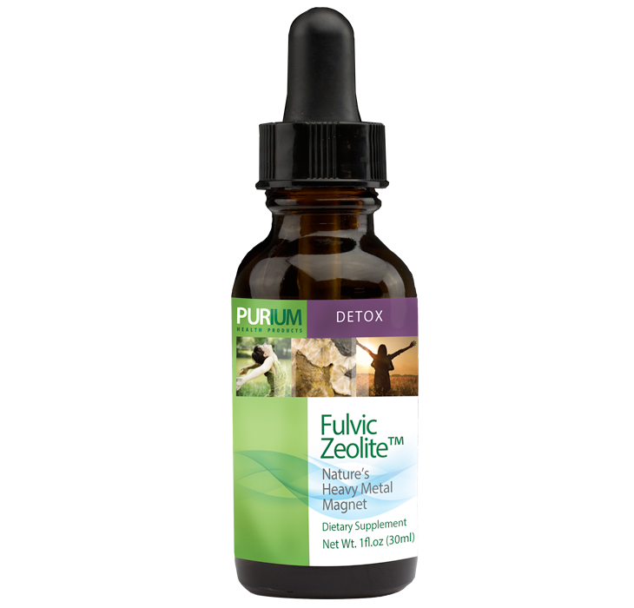
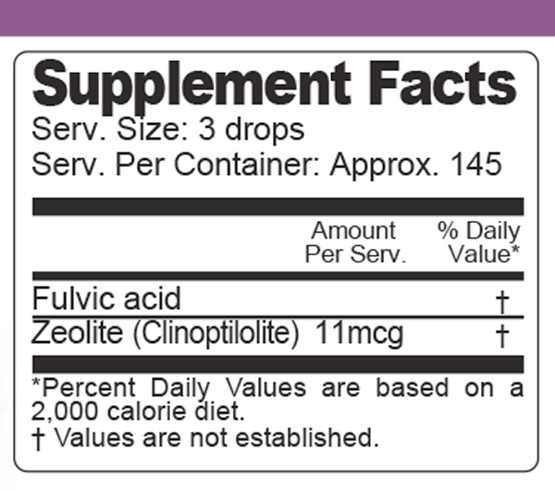
Fulvic Zeolite

Slide 28
Fulvic Zeolite
What it is: This natural detoxifier is created through one of the most dramatic forces of nature- volcanic activity. Due to the unique structure of the Zeolite molecule and the fact that it is one of the few negatively charged minerals in nature, it acts like a magnet drawing positively charged toxins and heavy metals out of the body.
Benefits:
Is an effective part of any detoxification program
Contains no chemicals
Balances pH levels and helps restore electrical conductivity in the body

Slide 29
Fulvic Zeolite
Interesting Facts:
The naturally occurring clinoptilolite class of Zeolite has been used for over 800 years in traditional medicine. For centuries, the powdered forms of specific Zeolites have been used as traditional remedies throughout Asia, specifically India, China, and Russia, to promote overall health and well being. The story of the "volcanic rocks" has been passed down from generation-to-generation as more and more people have experienced its life-changing benefits.
In the United States, Zeolites have been used in water filtration, air purification, in animal feed and even in fertilizers to keep the crops healthy. Now we`re using it in an enhanced form using a proprietary activation technology as a dietary supplement. In fact, because it is one of the few negatively charged minerals in nature, Zeolites act as a magnet as they draw toxins to it, capture them in its cage, and then gently remove them from the body.

Slide 30
Fulvic Zeolite
Interesting Facts:
Industrial Zeolite was used to clean up the Exxon Valdez oil spill of 1989 and over 50 metric tons were used to "detox" Chernobyl after the greatest nuclear disaster in history.
There are about 40 naturally occurring Zeolites and over 100 synthetic Zeolites. There are three different classes of Zeolites with varying molecular chemical structures:
Chain-like structures whose minerals form acicular, or needle-like, prismatic crystals - as found in asbestos.
Framework structures where the crystals are more equal in dimensions - as found in chabazite.
Sheet-like structures where the crystals are flattened - as found in clinoptilolite.
We use naturally occurring clinoptilolite. This particular Zeolite has been used for over 800 years in traditional medicine to improve general health.

Slide 31
Fulvic Zeolite
Interesting Facts:
Zeolite`s unique complex contains honeycombed structures or cages that allow small molecules between 2 and 10 angstroms to enter. This framework acts on a cellular level as a collection receptacle for toxic substances to be eliminated from the body.
Zeolites have large open spaces or cages in their structures that form channels. These channels allow the easy movement of ions and molecules into and out of the structure. This ability puts Zeolites in the class of materials known as "molecular sieves." The natural properties of Zeolites act as molecular sieves, or filtering agents, that attract and trap into them positively charged atoms, ions, and compounds, and can remove them from a system.

Slide 32
Fulvic Zeolite
Interesting Facts:
It`s a mineral with a cage-like structure that is created by aluminum and silica that are trapped in small tetrahedra (pyramid-like structures) created by oxygen atoms. These form 8-sided and 10-sided rings that stack on top of each other to form channels. The aluminum is positively charged and the oxygen around it is negatively charged, giving the entire molecule a net negative charge. This is a very stable compound. For all practical purposes, this is an invincible molecule.
Zeolite has been studied extensively by scientists around the world and is classified as GRAS (Generally Regarded As Safe). They are sold as food and tested to not have a negative effect on the body.

Slide 33
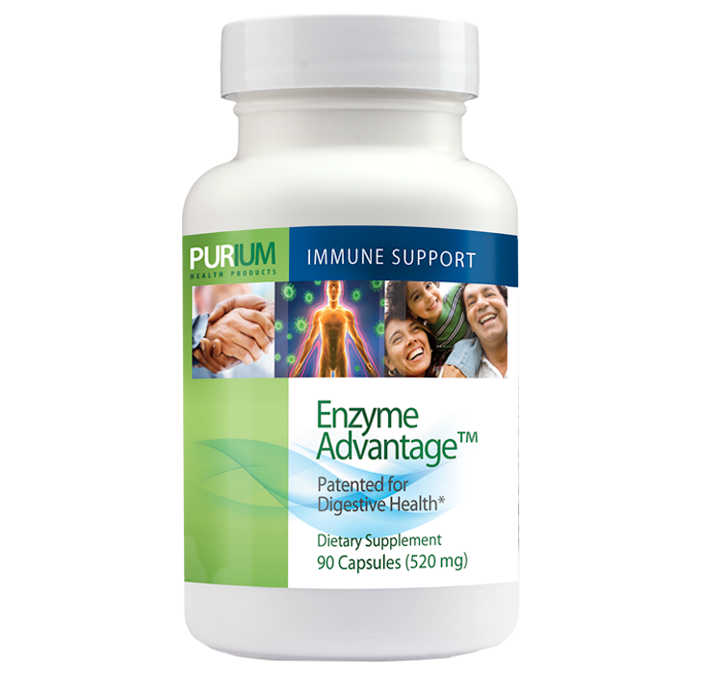
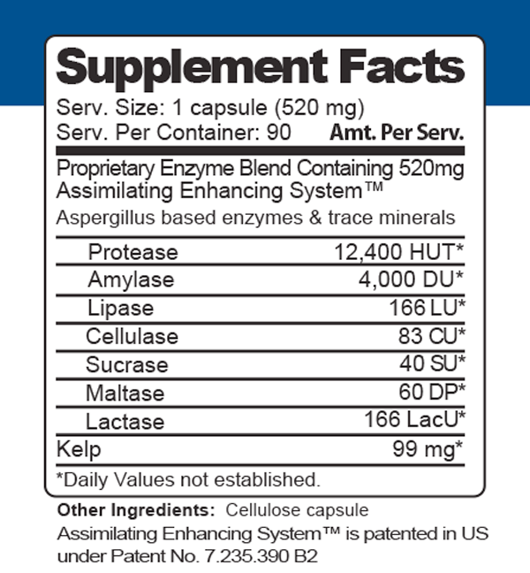
Enzyme Advantage

Slide 34
Enzyme Advantage
What it is: Enzyme Advantage is a patented, shelf-stable, aspergillus derived formula that helps your body break down and assimilate nutrients in the foods you eat. This also ensures that no food remains in your body undigested, causing gastrointestinal distress or discomfort.
Benefits:
May support healthy digestion
Can help eliminate toxins
May support healthy immune function
May enhance nutrient absorption when taken with meals
May be used as part of a natural allergy defense regimen

Slide 35
Enzyme Advantage
Interesting Facts:
Enzyme AdvantageTM can be taken with food to ensure total digestion or alone to help cleanse or detoxify your body.
Use Enzyme AdvantageTM with any nutritional supplement to maximize its effect.
Nearly all types of digestive problems can benefit from enzyme therapy.
Digestive enzymes are proteins specifically tailored to break down foods into nutrients that your body can then readily digest. The human body produces some 22 different digestive enzymes. Many more are found in the fruits, vegetables, meats, grains, and other foods.

Slide 36
Enzyme Advantage
Interesting Facts:
Most people mix many foods in one meal (meat, potatoes, sugary beverages and dessert), but unfortunately, our bodies are not built by nature to handle this so, we only digest proteins or carbohydrates at one time, but not both. This leads to undigested foods that may putrefy and cause decomposing food waste to poison the blood stream. Many people experience allergies, gastro intestinal distress, constipation, ulcers and other unpleasant conditions caused primarily by poor digestion. When you eat a meal, digestive enzymes that are released from your salivary glands, stomach, and small intestine immediately get to work to speed up the digestive process. Each enzyme acts on a specific type of food. A variety of different proteases, for example, break down the components of protein. Amalyses help digest carbohydrates; lipases break down fats; and cellulases, found in plants, digest fiber.

Slide 37
Enzyme Advantage
Interesting Facts:
Although definitive studies are lacking, some practitioners prescribe high-dose enzyme therapy as adjunctive (supportive) treatment for cancers of the pancreas, lung, colon, and other organs. Enzymes are also given to soothe side effects from harsh chemotherapy and radiation regimens. Some physicians who use alternative therapies to treat cancer include high doses of enzymes because they believe the enzymes can have a direct effect on the cancer itself.
Nutritionally oriented doctors often turn to digestive enzyme products to promote good digestion and enhance nutrient absorption. They contend that many people are lacking enzymes because of inadequate diets, over-refined foods, environmental toxins, and poor health. Such symptoms as bloating, gas, heartburn, and indigestion are thought to be a common result. Taking this further, some practitioners also believe that even in the absence of symptoms many people can benefit from routinely taking extra enzymes to maintain peak digestion and enhance storage of vital nutrients.

Slide 38
Enzyme Advantage
Interesting Facts:
Conventionally trained physicians, including gastroenterologists, sometimes recommend enzymes as well. In general though, conventional practitioners tend to believe that most people get all the enzymes they need barring those they deem to have "true enzyme deficiency" (which they detect with a stool analysis). Some doctors prescribe Pancreatin, a digestive enzyme that comes from the pancreas of pigs to treat chronic pancreatitis, though this is an uncommon condition. Far more commonly however, conventional doctors recommend over-the-counter enzyme products for those with lactose intolerance or chronic gas.

Slide 39
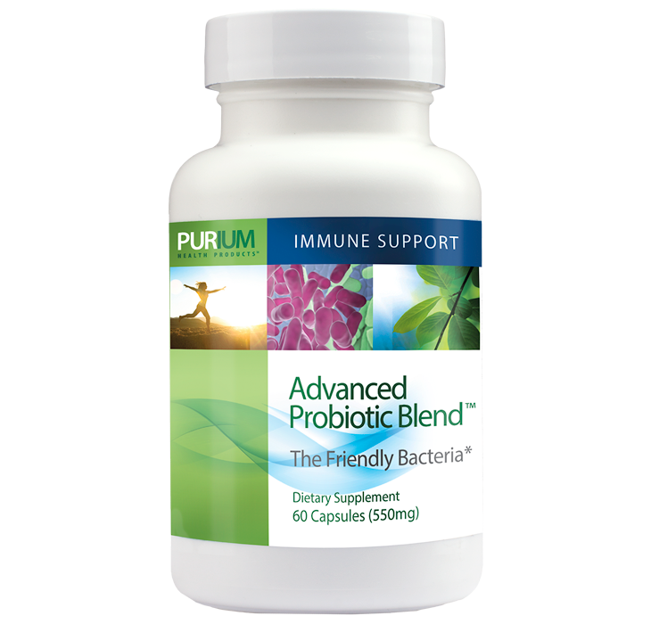
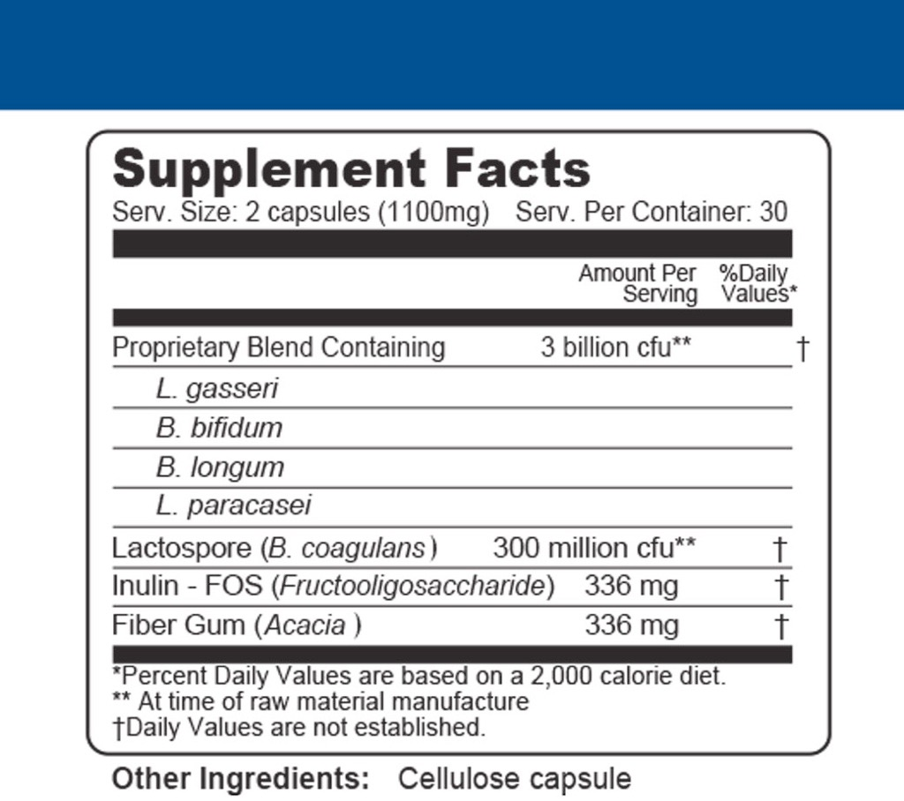
Advanced Probiotic

Slide 40
Advanced Probiotic
What it is: A potent, all-vegetarian, synergistic and shelf-stable blend of the most vital "friendly" bacteria available.
Benefits:
Repopulation of friendly bacteria and therefore the return of intestinal flora to a healthier balance
Nutritional assistance in the body`s normal response to yeast. Helps body to fight of yeast infections and Candida
May help prevent or reduce urinary tract infections
Aid in digestion, especially the digestion of proteins
Reduction of bowel toxins - reduction of gas, bloating, and intestinal and systemic toxicity
Prevention of diarrhea and constipation, improvement of chronic bowel disease symptoms
Boost to the immune system, as well as an anticancer effect
A reduction in serum cholesterol
Protection of liver function
May help athletes to reduce the amount of infections and to recover faster from infections than those who do not take probiotics, according to a study published in the British Journal of Sports Medicine.
Provision of nutrients to intestinal cells and enhancement of nutrient absorption.
Probiotics eliminate allergens from the blood before they cause a histamine reaction, therefore eliminating the need for anti-histamines.

Slide 41
Advanced Probiotic
Interesting Facts:
Purium`s Advanced Probiotic Blend is patented and clinically proven to restore friendly bacteria to the bowels.
Doctors and scientists in Europe have long recognized the need for anyone using antibiotics to take a `probiotic,` which will help the bowel rebuild the good bacteria that are killed by the pharmaceutical drugs. This is very helpful for women who are susceptible to yeast infections, Candida albicans and chronic fatigue
FOS (Inulin) promotes the growth of the beneficial bowel bacteria (lactobacillus acidophilus and bifidus), beneficial effects are reduction of bowel toxins, the prevention of diarrhea and constipation, a reduction in serum cholesterol, the protection of liver function, an anticancer effect and an improvement of chronic inflammatory bowel disease symptoms.

Slide 42
Advanced Probiotic
Interesting Facts:
F-19 is friendly bacteria that supports the digestion of protein, reduces fungus infestations, lowers blood cholesterol, aids general digestion, and enhances nutrient absorption.
Acacia Gum provides fiber enrichment and prebiotic effect to improve digestive health and improve regularity.

Slide 43
Advanced Probiotic
Final word from Dave:
Advanced Probiotic Blend is simply the most shelf-stable and most effective vegetarian probiotic ever developed. It is used in hospitals in Japan and is even known to be safe for adolescents (who typically should avoid introducing foreign gut bacteria). Complex in its simplicity, the 2 powerful acido- and bifido-bacteria along with the paracasei create harmonious integration with your existing flora versus less complimentary complex products which act instead as an invading army.
- Dave Sandoval

Slide 44
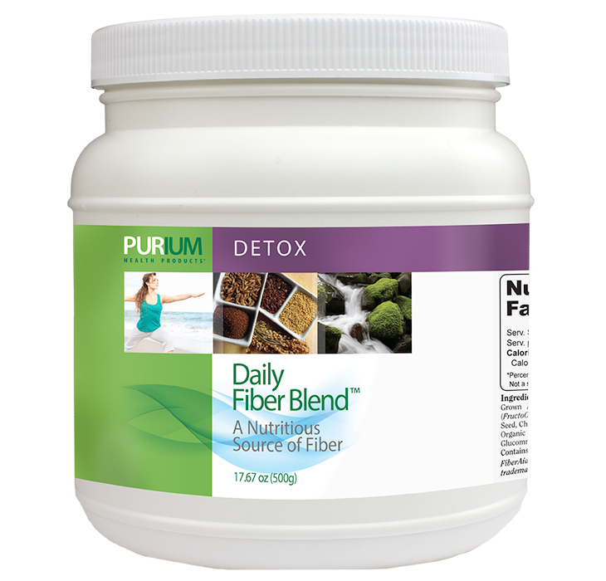
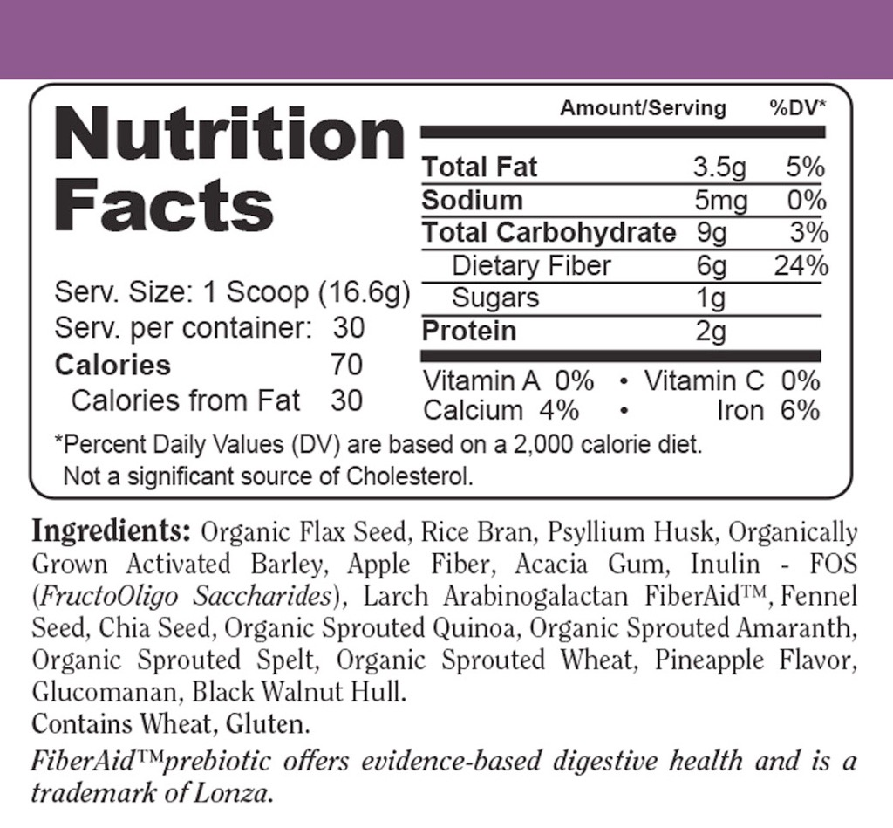
Daily Fiber Blend

Slide 45
Daily Fiber Blend
What it is: A proprietary blend of the most effective, gentle, and naturally acting dietary fiber. Unlike other fiber products, the Daily Fiber Blend recognizes the need to also create lubrication with foods containing healing essential fats, and to reduce discomfort by balancing the "roughage" with soluble fibers, which cleanse the blood stream as well as the colon.
Benefits:
May enhance bowel function
Supports healthy cardiovascular function
Contains highly digestible amino acids
May support a weight loss regimen

Slide 46
Daily Fiber Blend
Interesting Facts:
Studies show that fiber is more essential to daily living then previously understood.
Flaxseed oil is rich in alpha linolenic acid, an omega-3 fat that is a precursor to the form of omega-3 found in fish oils called eicosapentaenoic acid or EPA. Alpha linolenic acid or ALA, in addition to providing several beneficial effects of its own, can be converted in the body to EPA, thus providing EPA`s beneficial effects.
Glucomannan is a water-soluble dietary fiber obtained from the root of the Konjac plant found throughout Asia. Nearly calorie-free, glucomannan has been consumed as a food (in noodles, tofu, etc.) for over 1000 years. Recent studies have shown that its health benefits may include: cholesterol reduction, blood sugar regulation, constipation relief, and appetite suppression.

Slide 47
Daily Fiber Blend
Interesting Facts:
The term `heirloom` has been applied to the ancient grains (quinoa, amaranth, spelt, and Kamut) to further describe their unique stature among all foods as a pure, non hybrid. The sprouting process employed for these ancient grains creates living enzymes like S.O.D. (Super oxide Dismutase) and catalysts., which are plant versions of the most powerful antioxidants produced by the human body.
Psyllium husk has been tested in numerous studies and has proven to be quite substantial in lowering cholesterol.
Not only good for regularity; Inulin/ FOS may help maintain a healthy cholesterol level and aid your cardiovascular system.
Researchers found increasing whole grain foods, such as Aktivated Barley, in a healthy diet might reduce risk factors associated with excess weight, type 2 diabetes mellitus and cardiovascular disease.

Slide 48
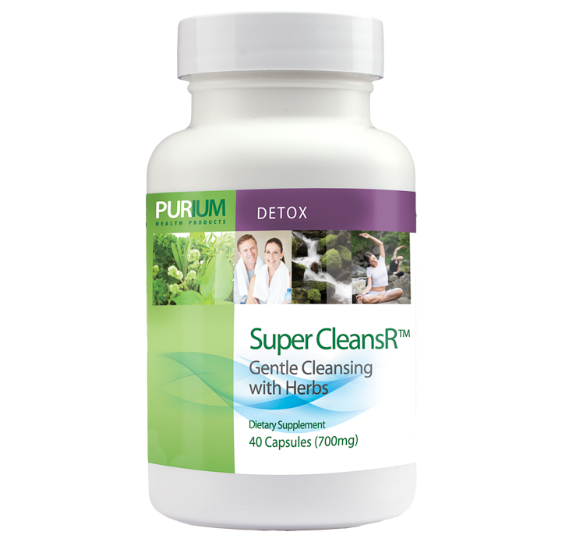
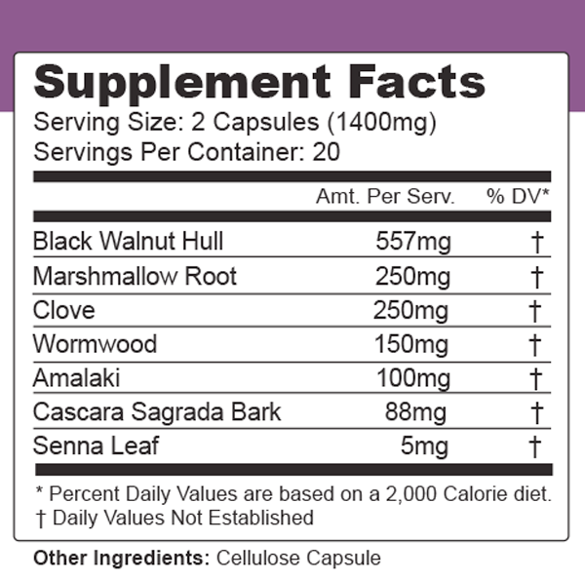
Super CleansR

Slide 49
Super CleansR
A Gentle, Deep, Effective CleansR
Increases peristaltic action
Reduces constipation
Enhances deep cleansing
Gentle yet effective parasite defense
Super CleansR is a unique combo of herbs & superfoods that stimulates peristaltic action and elimination gently and effectively. It also contains ingredients that have been shown to help defend your body from some parasites.

Slide 50
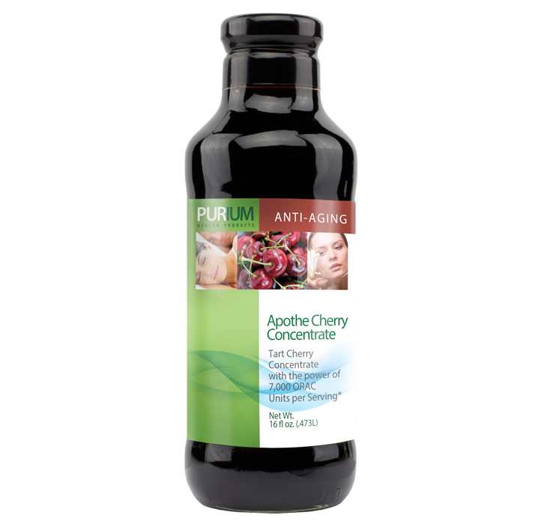
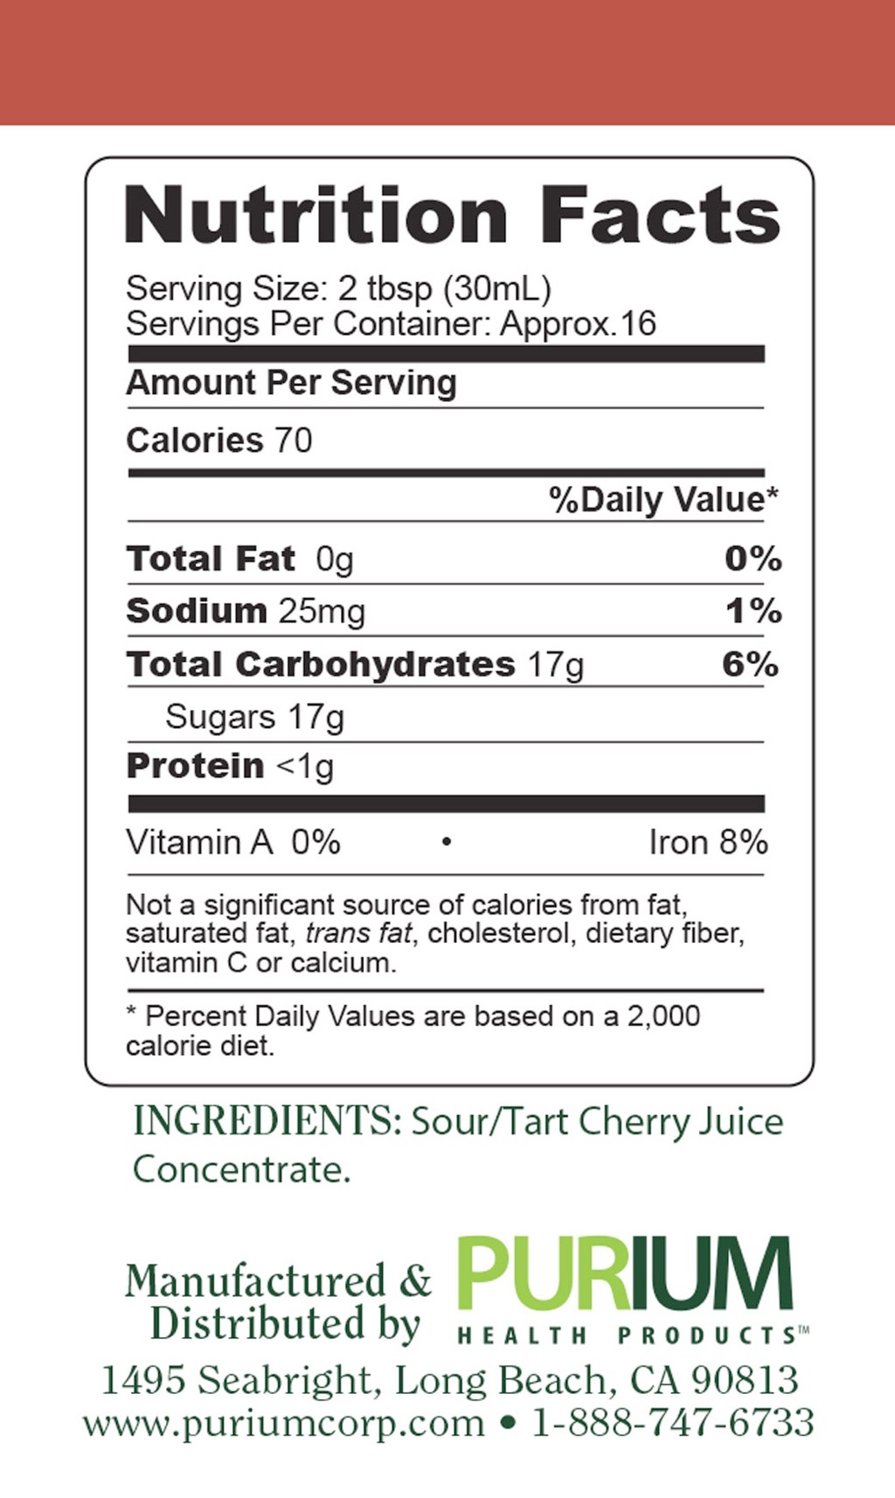
Apothe Cherry

Slide 51
Apothe Cherry
What it is: Purium`s Apothe-Cherry is a liquid extract that condenses the nutritional potency of 30 tart cherries into 1 oz.
Benefits:
Contains melatonin, which may help balance circadian rhythms for proper sleep
May support healthy joint function
Promotes healthy uric acid metabolism
Is a rich source of anti-oxidants
Can help prevent or even reverse premature aging

Slide 52
Apothe Cherry
Interesting Facts:
Researchers at the Human Aging Institute found that when 5,000 ORAC units a day are consumed through food, the risk of disease and premature aging are substantially reduced. We`ve captured the health-promoting benefits of tart cherries in the most nutritionally potent fruit juice available- each delicious serving contains over 7000 ORAC units.
Tart cherries were once only used to make pies and, due to their tart taste, the bakers replaced some of the juice with sugar. Not until university empirical studies showing the benefits of consuming tart cherries began to surface did we realize that tart cherry eaters had far less gout and arthritis than those who didn`t eat any at all.

Slide 53
Apothe Cherry
Interesting Facts:
Has more ellagic acid than pomegranates
More anthocyanins than blueberries
Higher ORAC rating than acai
Better for gout than black cherry
Far more scientific validation than goji, mangosteen, or noni

Slide 54
Apothe Cherry
Final word from Dave:
My grandmother always used black cherries to help control my grandfathers gout, I remember her counting out 100 cherries just as her grandmother had done for her father, today science shows us that sour / tart cherries contain 3 - 5 X more of the phytochemicals that grandma was seeking. Each ounce of our Apothe-Cherry is equal to the juice from 33 sour cherries and more than 100 black cherries; my grandma would be proud.
- Dave Sandoval

Slide 55
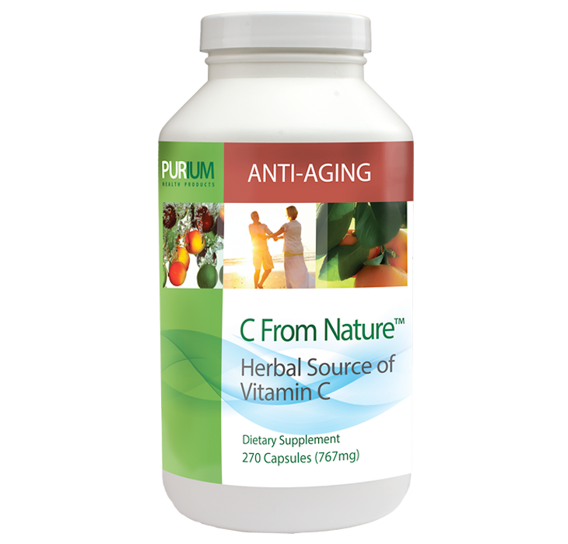
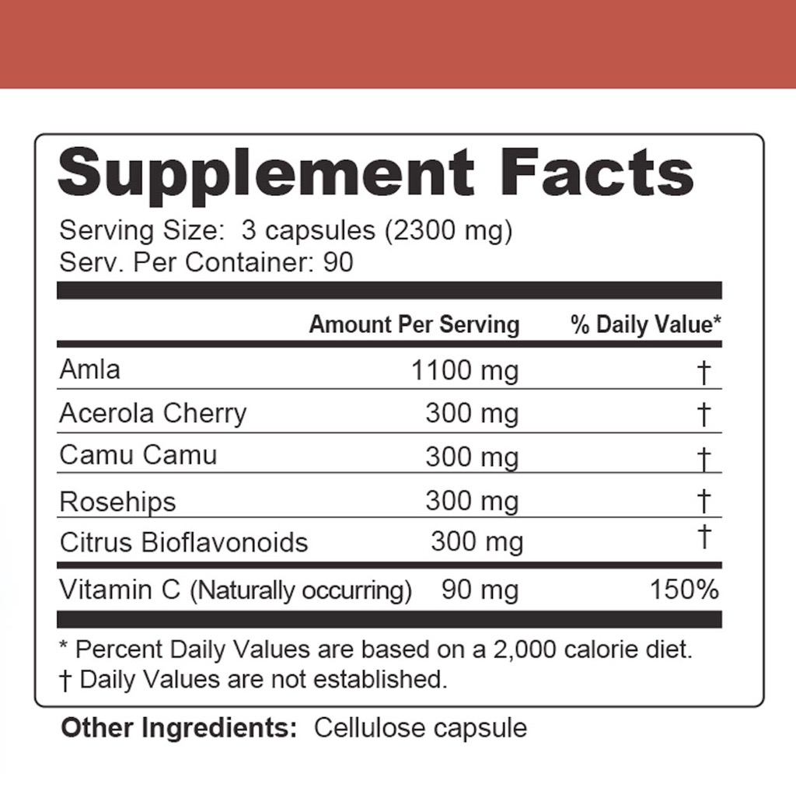
C From Nature

Slide 56
C From Nature
What it is: A proprietary blend of the most potent whole food sources of natural vitamin C.
Benefits:
1 May help support a healthy immune system and reduce the onset of colds or the flu and/or aging related degeneration of health.

Slide 57
C From Nature
Interesting Facts:
Amalaki or Amla berry has been used for centuries. It was featured in a 7th century Ayurvedic medical text as the best medicine to prevent aging. In traditional Ayurvedic medicine it is also known for its` immune-enhancing benefits and as a general tonic for optimal health. Amla has been specifically indicated for people with anemia, asthma, bleeding gums, diabetes, colds, chronic lung disease, hyperlipidemia, yeast infections, scurvy, and cancer to use for treatment and prevention. It is an ancient Indian berry, `Amalaki`, is a source of vitamin C that is 12 times more assimilable than synthetic ascorbic acid. There is no better source of natural vitamin C than Amalaki- AKA Amla berry.
Acerola cherry is known to reduce inflammation, prevent and treat upper respiratory infection, stimulate the immune system, and act as a potent antioxidant. The fruit of the Acerola Cherry tree can contain up to 400mg of Vitamin C per gram of fresh berry compared to 5mg in a peeled orange.

Slide 58
C From Nature
Interesting Facts:
Camu-camu berry is a source of phosphorous, calcium, potassium, iron, the amino acids serine, Valine, and Leucine. Many have used camu-camu to support the immune system, maintain excellent eyesight, create beautiful skin, and help maintain optimal clarity of mind in times of stress and anxiety. It is a great source of antioxidants and is an anti-viral. In studies of botanicals camu-camu ranked #1 related to 12 common ailments that included colds and migraine headaches. Native to the Amazon River Region, Camu Camu has over 100 times the amount of Vitamin C per gram than an orange.
Rose hips are available throughout the USA. As their name implies, they come from the rose plant - they`re what remains after the petals fall off. Rose hips have been used as a source of nutrition for centuries and are a highly recognized source of vitamin C, they also contain vitamins E and K, and the B vitamins riboflavin and folate. Rose Hips have 20-40 times more Vitamin C than citrus fruit and is very rich in Bioflavonoids, which are vital to build and strengthen your body.

Slide 59
C From Nature
Interesting Facts:
Citrus Bioflavonoids help create collagen, help our bodies utilize vitamin C and keep our skin and connective tissues firm. These compounds are thought to work by strengthening the walls of the blood vessels and are widely used in Europe to treat diseases of the blood vessels and lymph, including hemorrhoids, chronic venous insufficiency, leg ulcers, easy bruising, nosebleeds, and lymphedema following breast cancer surgery. These substances found in citrus fruits have been shown in numerous studies to treat diseases of the blood vessels and the lymphatic system.

Slide 60
Aloe Vera
Final word from Dave:
Sailors returning from long voyages often suffered from scurvy; a lack of the nutrient vitamin C. If you had scurvy today and you sought out vitamin C from your nutrition store, your scurvy would not go away because today "ascorbic acid" is being sold as vitamin C even though it contains none of the nutrient by the same name. Ascorbic acid is an antioxidant created by nature to protect the nutrient vitamin C and today is synthetically manufactured from GMO corn and does not resemble the nutrient our body craves at all. We provide nature`s purest form of the vitamin C complex.
- Dave Sandoval

